Slide 1
Project NLP and Fine tuning
Group 3

Slide 2
Introduction

Slide 3
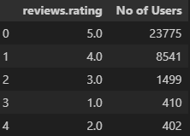
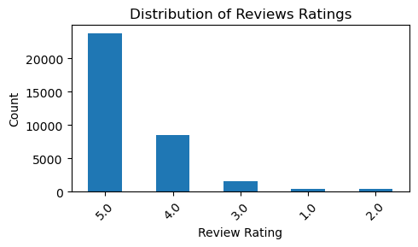
Traditional NLP & ML approaches
Dataset used: 1429_1.csv
From: https://www.Kaggle.com/datafiniti/consumer-reviews-of-amazon-products
a) Data Preprocessing
- We analyzed the dataset to determine which columns were really useful for the case.
- Check features that had null values and clean them.
- After removing columns that had most null values. By checking the distributions of the other feature, we determined that for the sentiment classifier, the most important feature are “reviews.text” (model input features) and “reviews.rating ( model target )

Slide 4
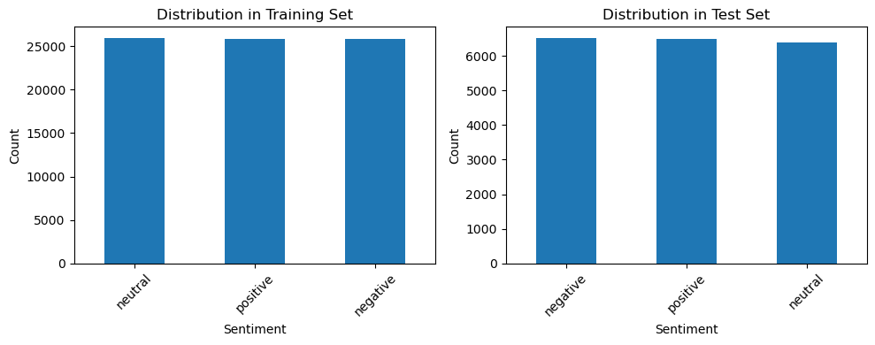
b) Clean Texts Tokenize and Remove stopwords
First split the dataset into features and target
To the input feature column (reviews.tex):
Clean stop words (NLTK)
Convert to lowercase
Remove punctuations
To the target column (reviews.rating):
creates a function to map rating to sentiments.
Positive (ratings 4-5)
Negative (ratings 1-2)
Neutral (ratings 3)
c) Vectorize text data using TF-IDF and Balancing
-Vectorize the clean reviews.text.
- I apply SMOTE on the vectorize data to balance the dataset.

Slide 5
Split data into Training and Test and Train using Different Traditional NLP and ML models

Slide 6
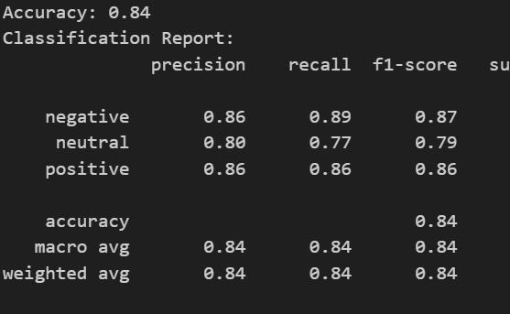
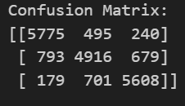
Naive Bayes

Slide 7
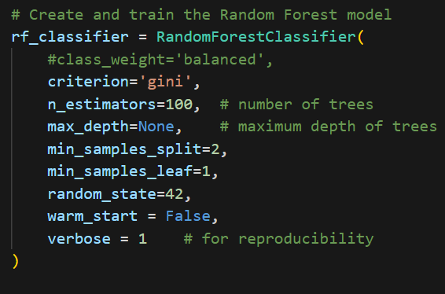
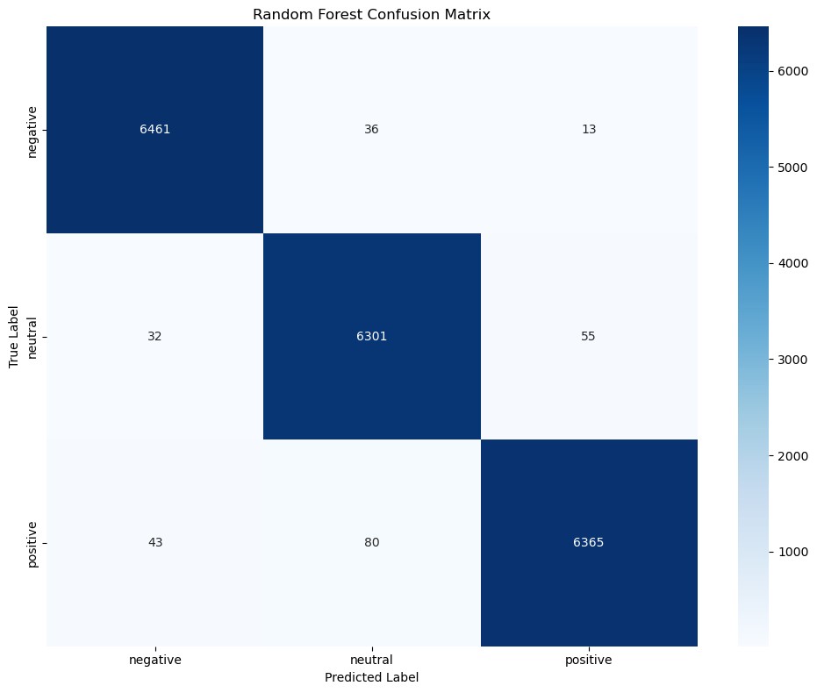
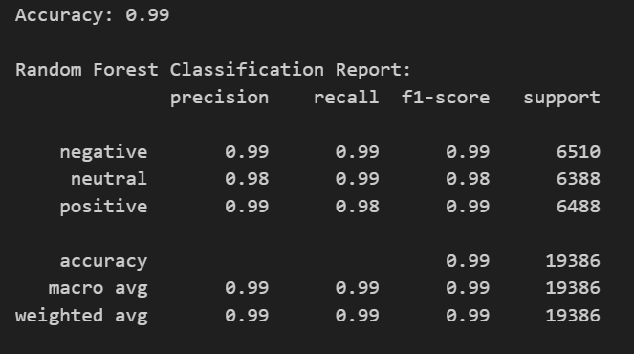
Random Forest

Slide 8

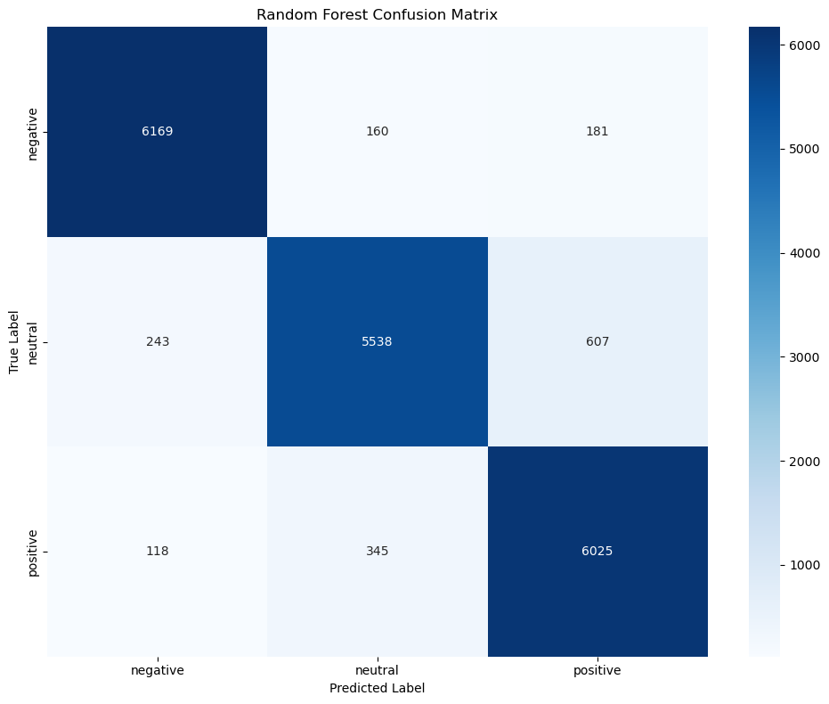
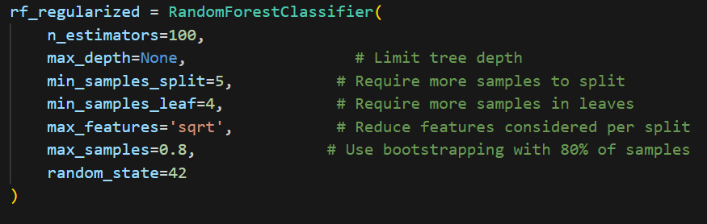
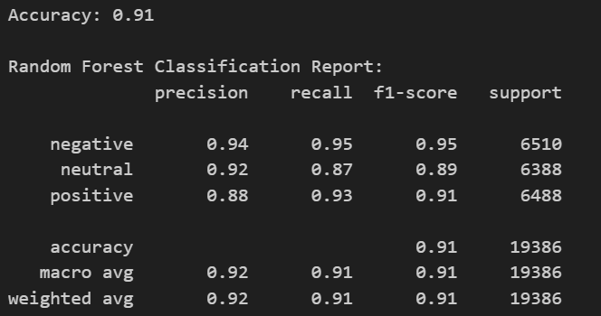
Random Forest L2 Regularize

Slide 9
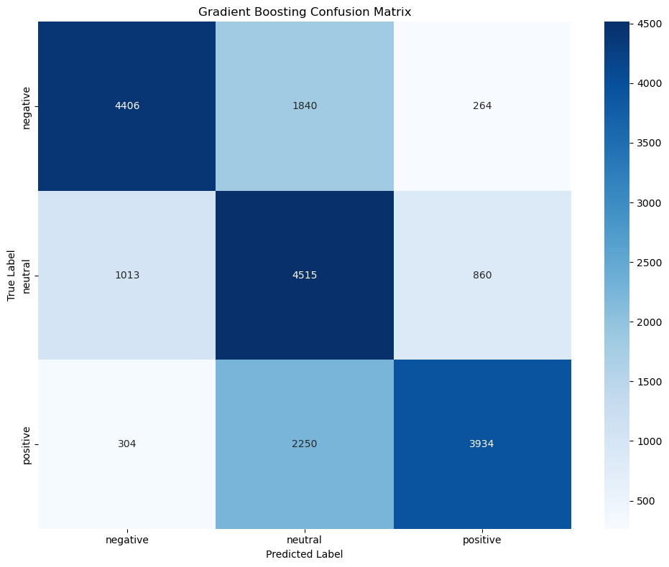
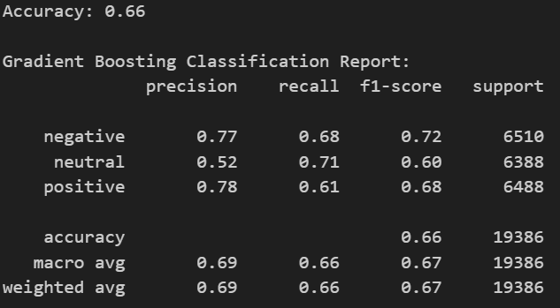
Gradient Boosting

Slide 10
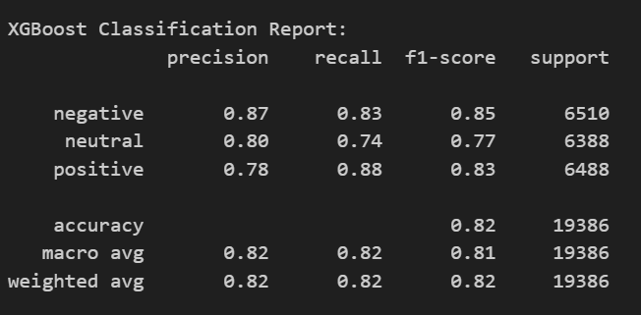
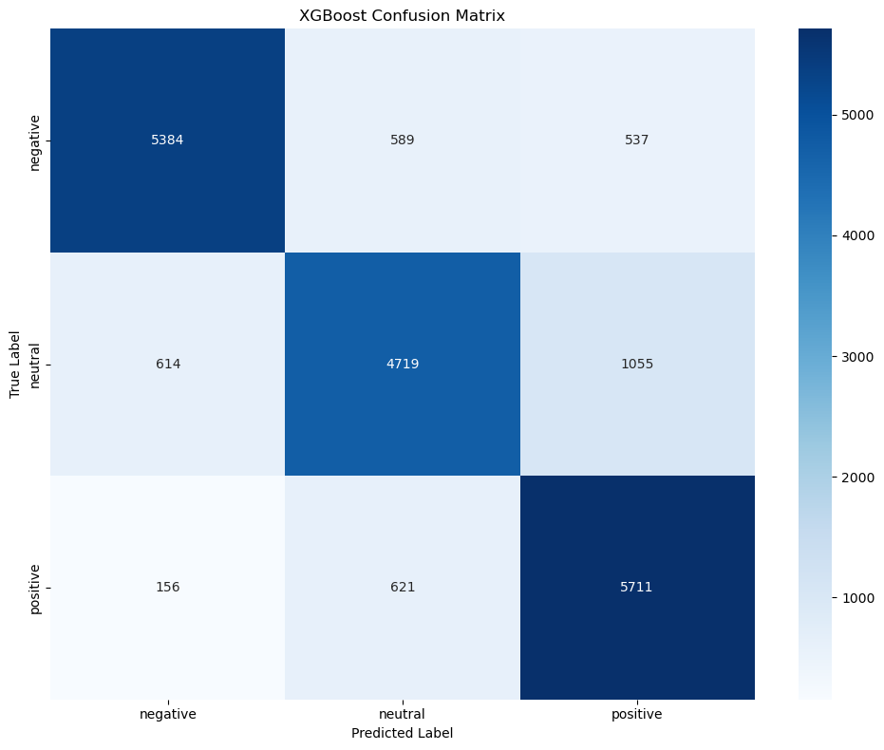
XgBOOST

Slide 11
Part 2: Sequence-to-Sequence modeling with LSTM
-Goal: Build a Bidirectional LSTM model to predict the review class i.e, negative, positive or neutral

Slide 12
a) I did the same data preprocessing as for the traditional NPL models:
Deleted unnecessary columns
Remove nulls
Remove stopword, punctuations.
Convert to lowercase
Word tokenize
Vectorize the data
Balance the data with SMOTE
Split data into training and validation datasets

Slide 13
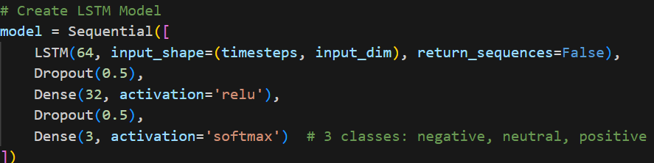
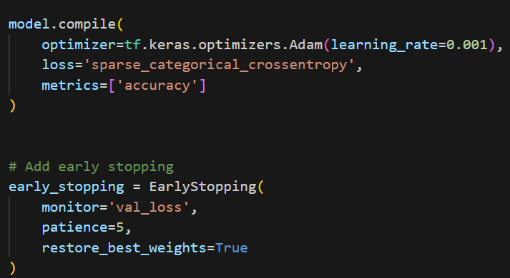
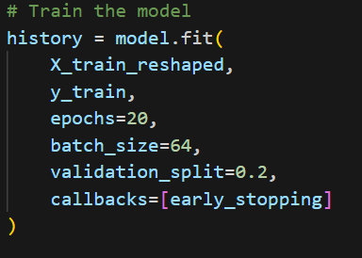
b) Train LSTM Model
-Reshape input data for LSTM (samples, timesteps, features)
Arquitecture:

Slide 14
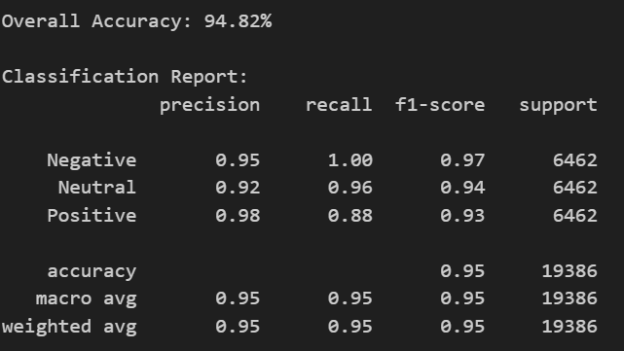
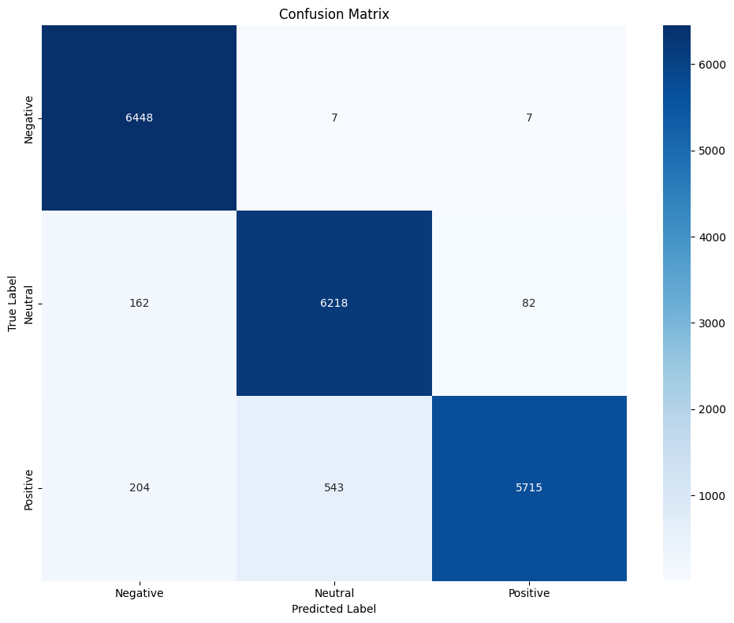
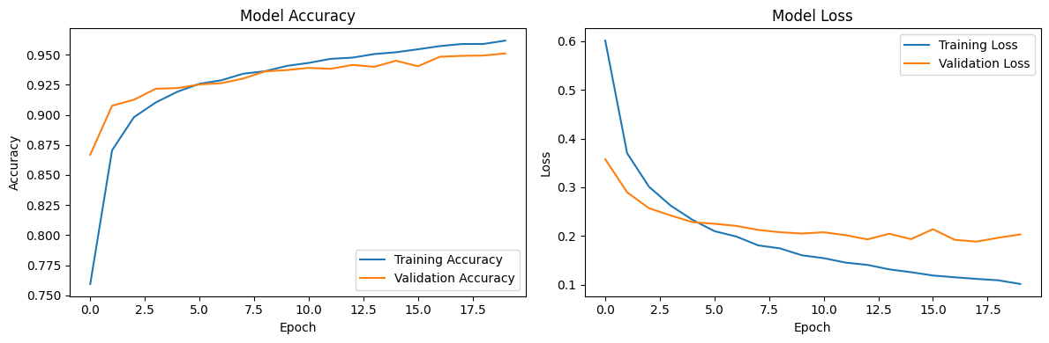
c) Evaluation
Report: Confusion Matrix: Accuracy and loss Plot:

Slide 15
3) Transformer approach (HuggingFace API)
-Goal: Model Selection
Explored transformer-based models available in the HuggingFace Transformers API, including:
BERT (Bidirectional Encoder Representations from Transformers)
RoBERTa (Robustly Optimized BERT Approach)
DistilBERT (Lightweight version of BERT)
...
Selected a pre-trained transformer model suitable for text classification tasks, and justify your choice.
The dataset used: Datafiniti_Amazon_Consumer_Reviews_of_Amazon_Products.csv from https://www.kaggle.com/datasets/datafiniti/consumer-reviews-of-amazon-products

Slide 16
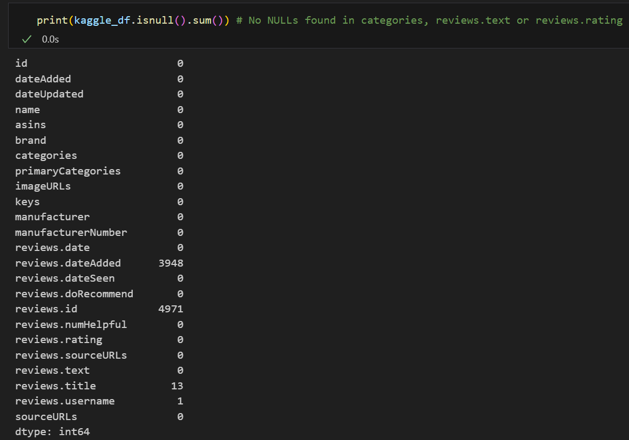
1. Data Preprocessing
Cleaning NULLS
Since the columns that were going to be used were “categories”, “review.rating” and “review.text”, and they didn’t have NULL values, eliminating the NULL fields was not needed.

Slide 17
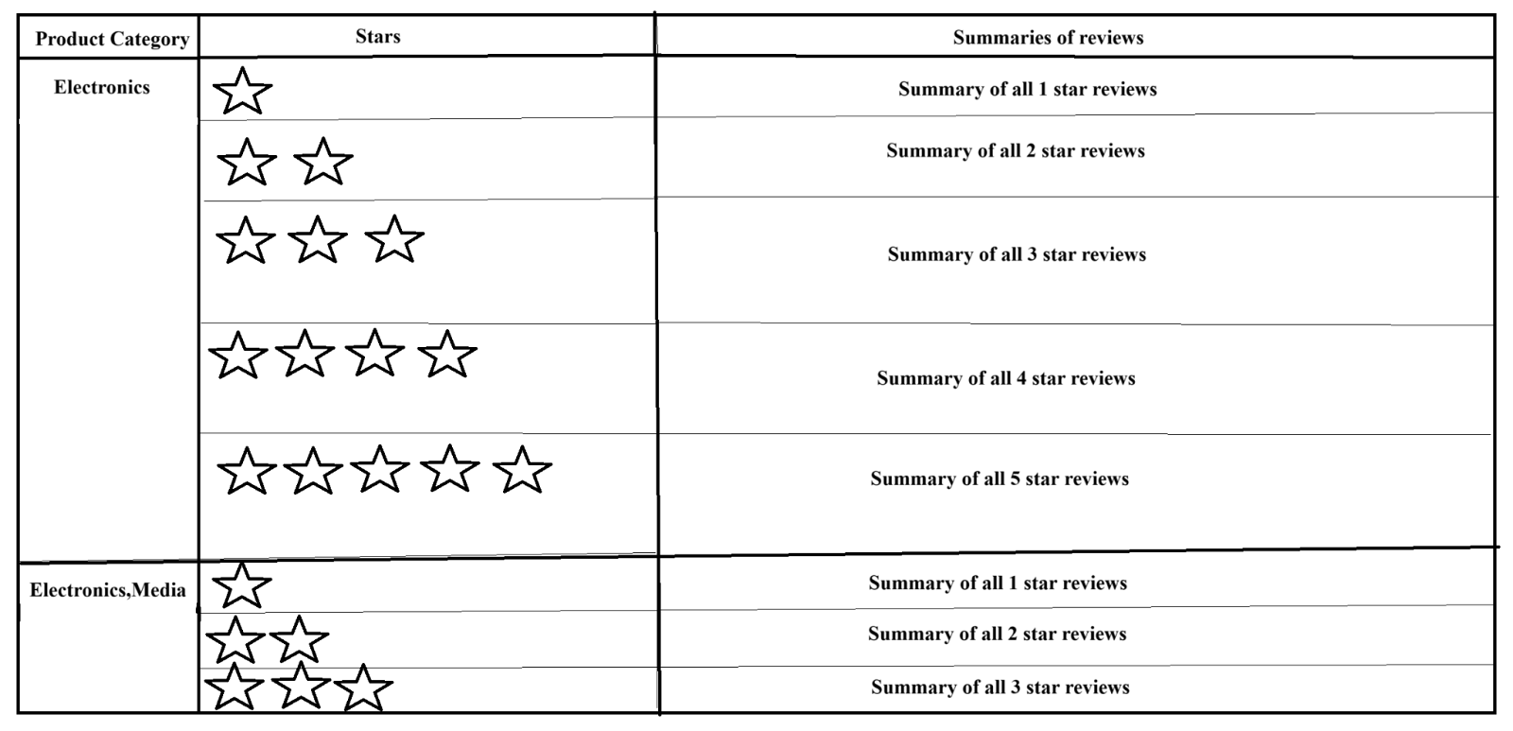
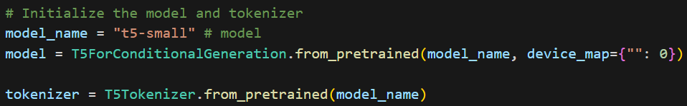
Transformer approach (HuggingFace API)
The goal was to have a summary of all reviews broken down by each star or rating, for all product categories. It would look like this, where every product had, for each rating, a single summarization of all reviews combined of that rating.
The dataset used: Datafiniti_Amazon_Consumer_Reviews_of_Amazon_Products.csv
from https://www.kaggle.com/datasets/datafiniti/consumer-reviews-of-amazon-products
The model used: t5-small from https://huggingface.co/google-t5/t5-small

Slide 18
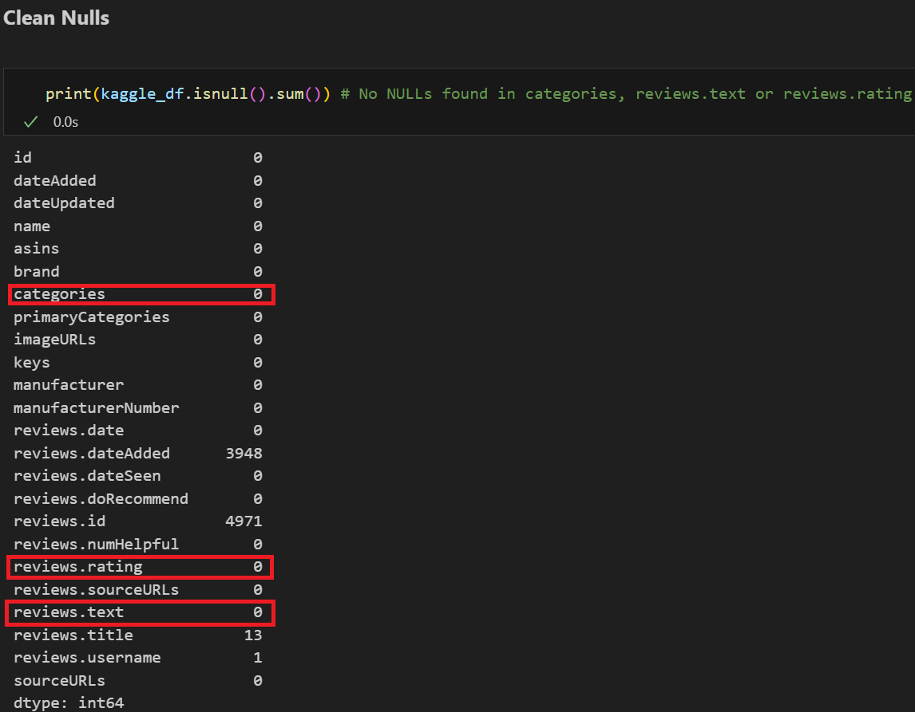
Data Preprocessing
1.1 Data Cleaning and Tokenization
Cleaning NULLS
Since the columns that were going to be used were “categories”, “review.rating” and “review.text”, and they didn’t have NULL values, eliminating the NULL fields was not needed.

Slide 19
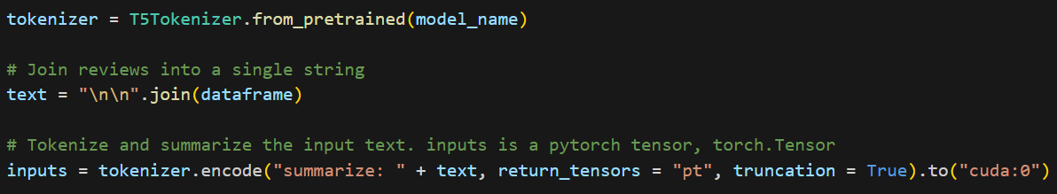
Tokenization
For the tokenization the T5 library provided an instruction to encode the data to be summarized.
Metrics:
Summarization models use ROUGE metrics instead of accuracy scores to verify how good the model is.
The ROUGE scores used were rouge1, rouge2, rougeL and rougeLsum.
The scores for the pre-trained model are:
rouge1 average: 0.0873561269402484
rouge2 average: 0.0
rougeL average: 0.08728537224163033
rougeLsum average: 0.0873561269402484

Slide 20
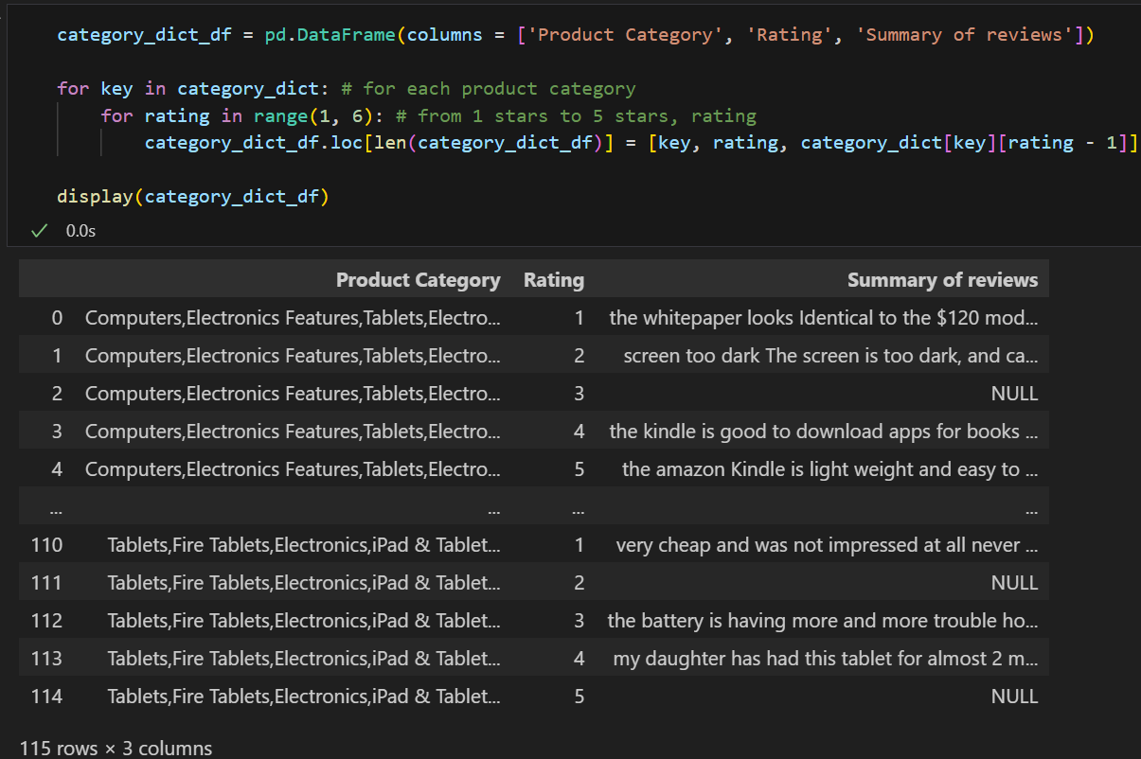
End Results:

